Slide 1

Presentation on Institute management site (department of computer science)
Aks university satna (University with difference)
Submitted by-
RAMBABU
BCA (Hons.) 5th semester
B1992R10400001
Submitted to-
Er. HARI MOHAN MISHRA
(Project Guide)

Slide 2
Introduction
Basically Institute management site is a portal site where student can see all the information related to Institute
And also they can apply for any courses which is running in institute
The best thing in this site that student can apply online for any course.
Students can also create their user id and password and see their all the information after login .
I have tried my best to make the complicated process of Institute Management Site as simple as possible using Structured & Modular technique & Menu oriented interface. I have tried to design the Project in such a way that students may not have any difficulty in using this package & further expansion is possible without much effort. Even though I cannot claim that this work to be entirely exhaustive, the main purpose of my exercise is to perform each Employee’s activity in a computerized way rather than manually which is time consuming.

Slide 3
Objective
Institute management site is basically used to build an application program which help students to take admission on institute with selected courses. It is useful in the way that it makes an easier way to see all the information of students online.

Slide 4
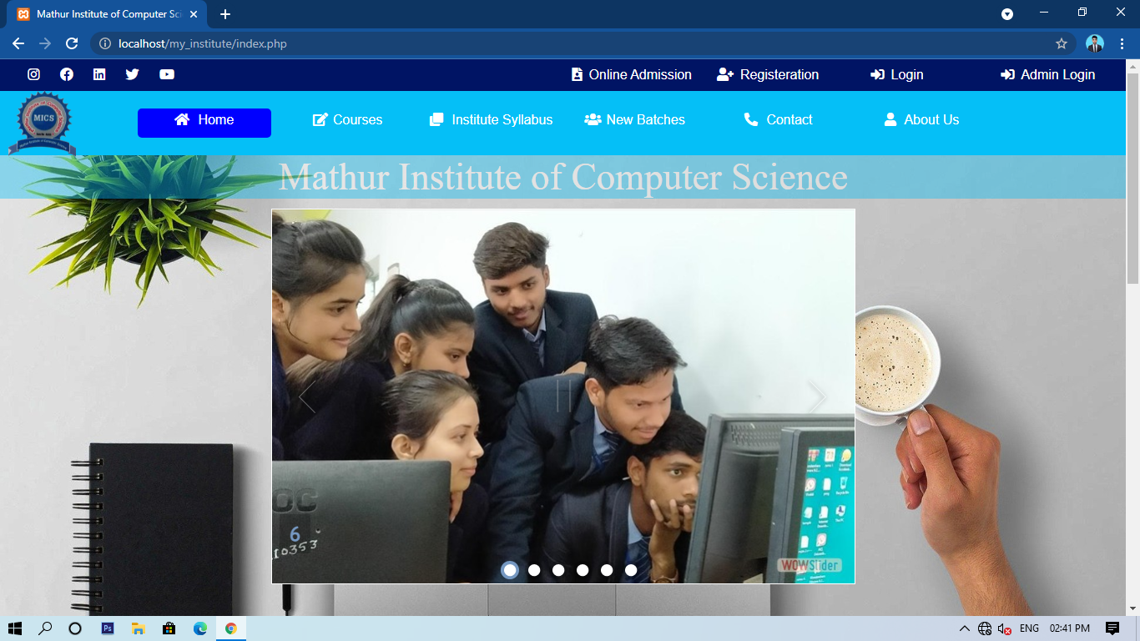
Home page (site view)

Slide 5
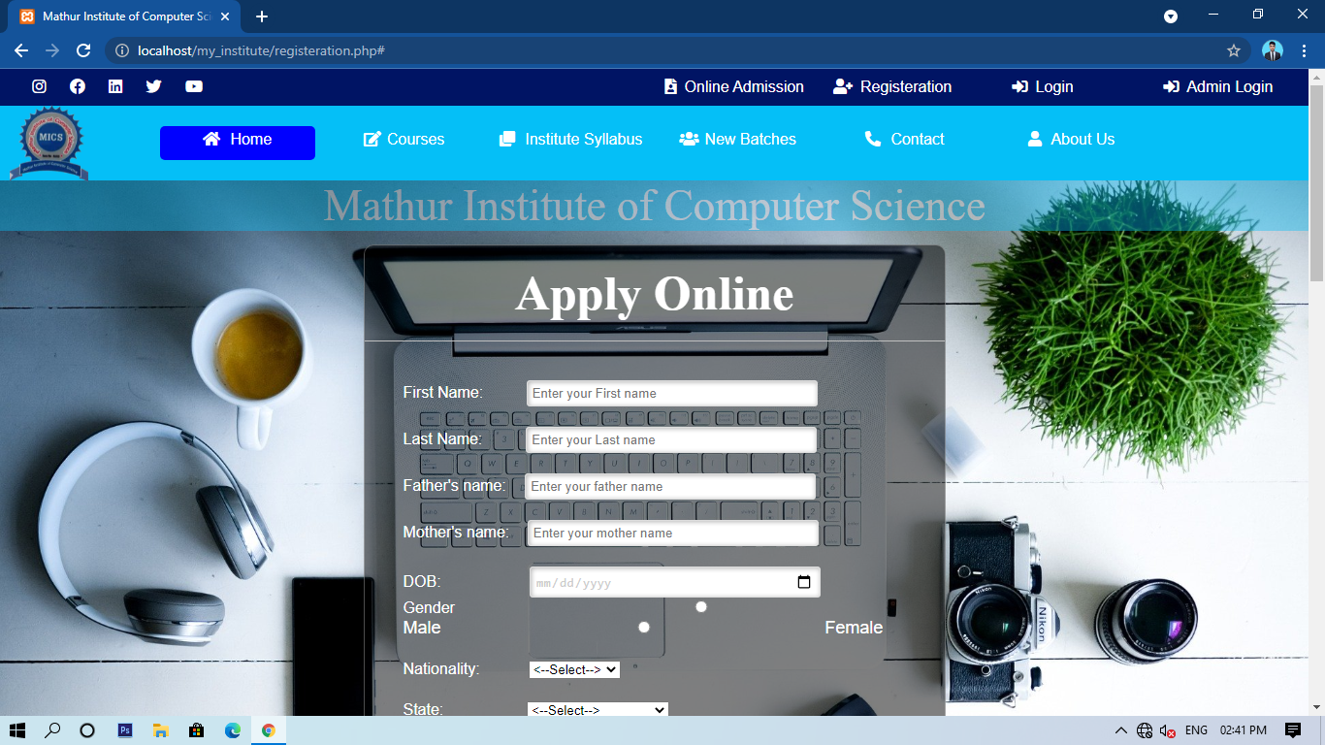
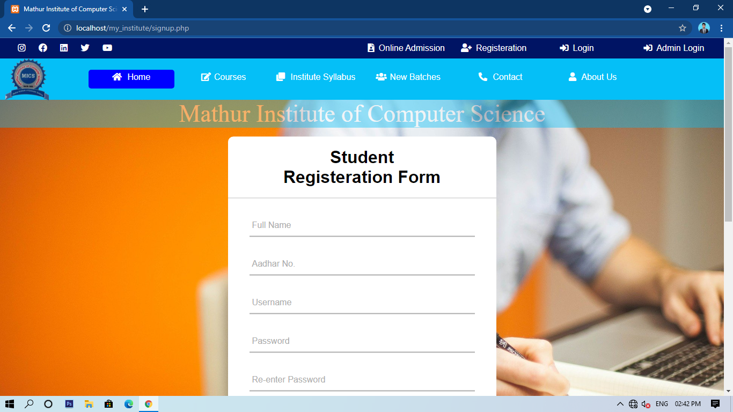
Student admission and registration form

Slide 6
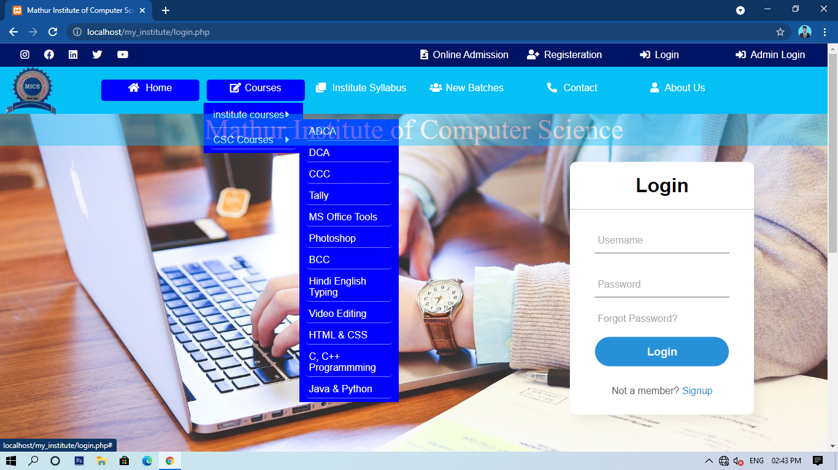
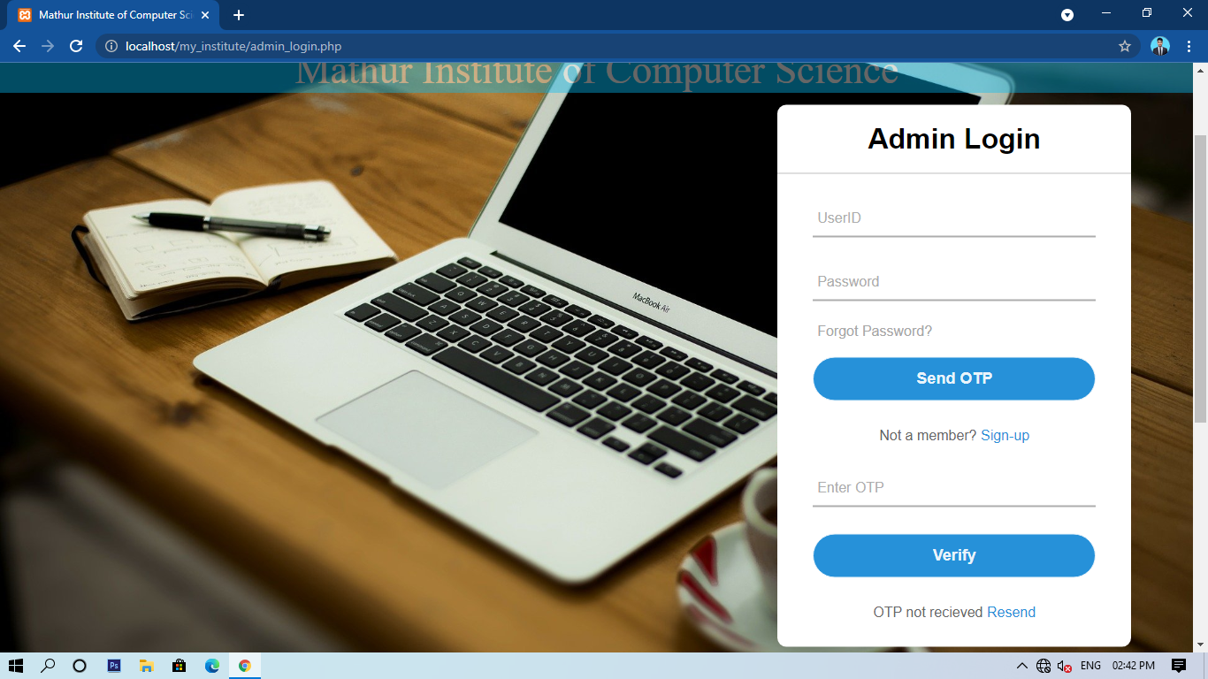
Student login and admin login page

Slide 7
Advantages
The advantages of Institute management site are that you can take admission without visiting to the institute.
The most important advantage of online Institute management site is convenience, you can take
The Internet helps you to browse through the Institutes around the world and compare the facilities and rates easily.
Easy to Use - Anyone of any age can use it easily.
Fast - Lightly coded and hosted in fast Server.
Efficient - Make learning efficient.

Slide 8
Disadvantage
Requires/Need internet.
Screen of a phone or electronic device could harm eyesight if spent more time learning digitally.

Slide 9
Limitations
Only limitation is that it can’t be accessed and interacted without internet

Slide 10
Future enhancement
I will add many module in the future.
Attendance module
Fees module
Online classes
Examination module

Slide 11
THANK YOU

